Slide 1
Covid Data Analysis
Team Ferocious 5
Ankitha Chavan
Ashritha Dasari
Deepika Dasaroju
Manogna Bobbili
Venkatesh Pulibandla

Slide 2
Agenda
Objective
Datasets
Data Exploration
Hypothesis testing
Modeling
Dashboard
Summary
References

Slide 3
Objective
Perform COVID Data analysis and deduce the impact of enrichment data on COVID infections.
Tasks:
Explore Datasets
COVID, Census Demographics, Employment, Hospital, Election, Social Economic Factors
Data Cleaning & Merging
Weekly Descriptive Statistics & Trend Plots
Initial Hypothesis
Distribution Plots
Hypothesis Testing
Modeling
Linear Regression
Polynomial Regression
Dashboard

Slide 4
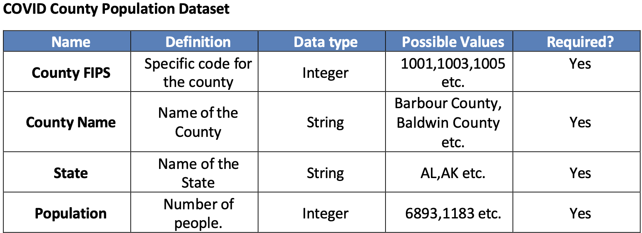
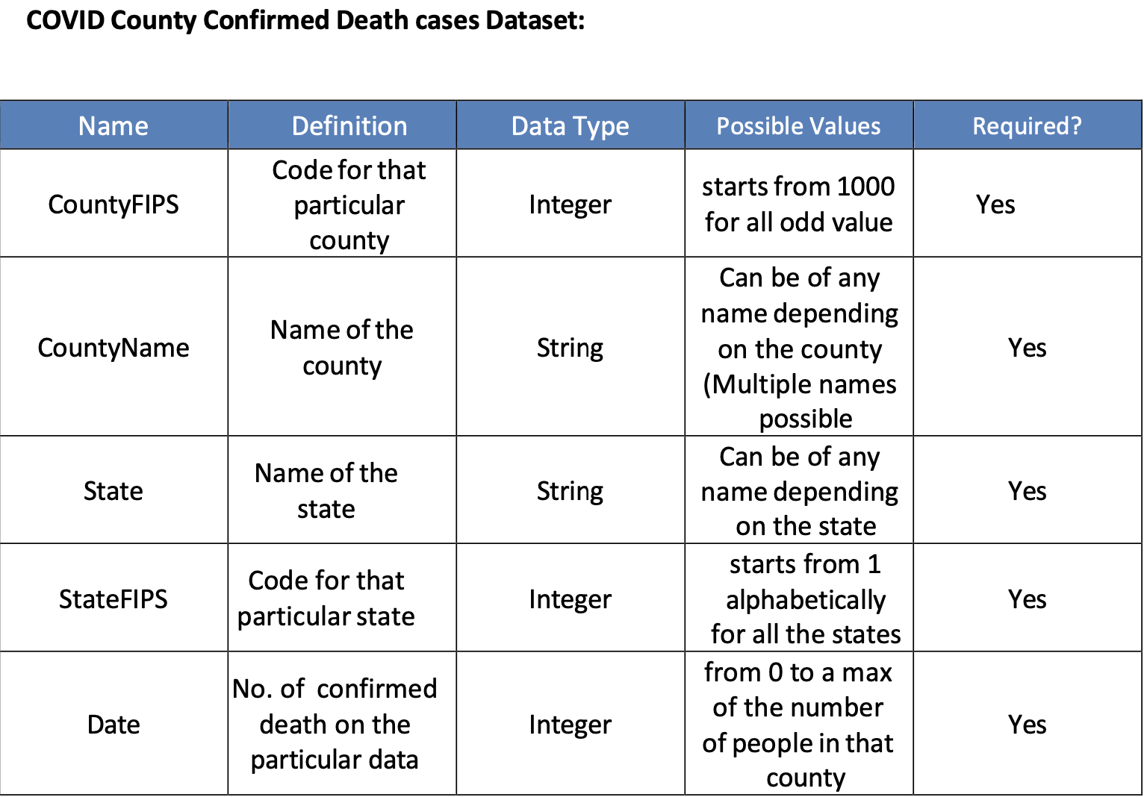
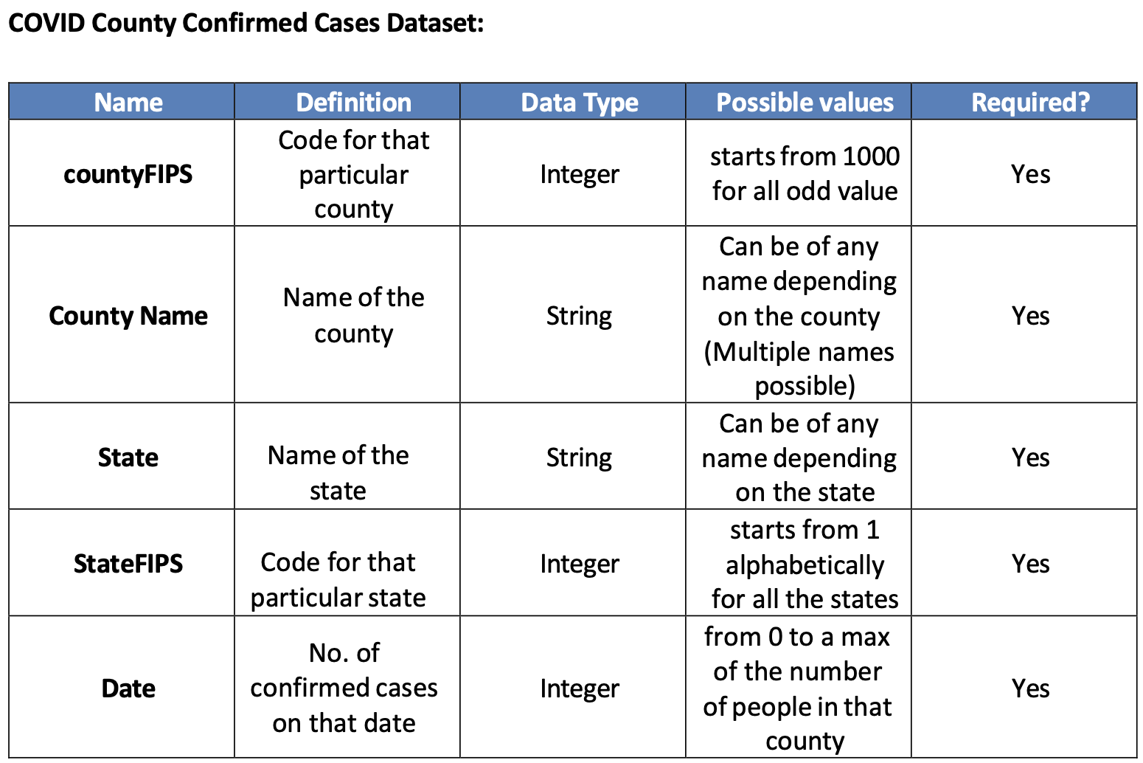
COVID Datasets

Slide 5
Enrichment Datasets
Demographics
Different races and different age groups population
Employment
Employment count, wages & industry data
State wise data
Hospital
Hospital Beds, Admissions, Bed Occupancy & Staff availability data
Adult, Pediatric data for normal and ICU bed categories
Housing
Election
2020 Election Data
President, Governor, Senate & House Election data
County Wise Data
Enrollment count and votes won by each party candidates
State wise data with each hospital address
Vaccination dosage data
Includes relative Wage Quotient and Employment Quotient with respect to US
Total occupied versus total vacant houses
No of rooms per house
Population of age groups 60 to 64
Total number of male citizens
Total no of housing units
* Data Dictionary Tables are available in Appendix

Slide 6
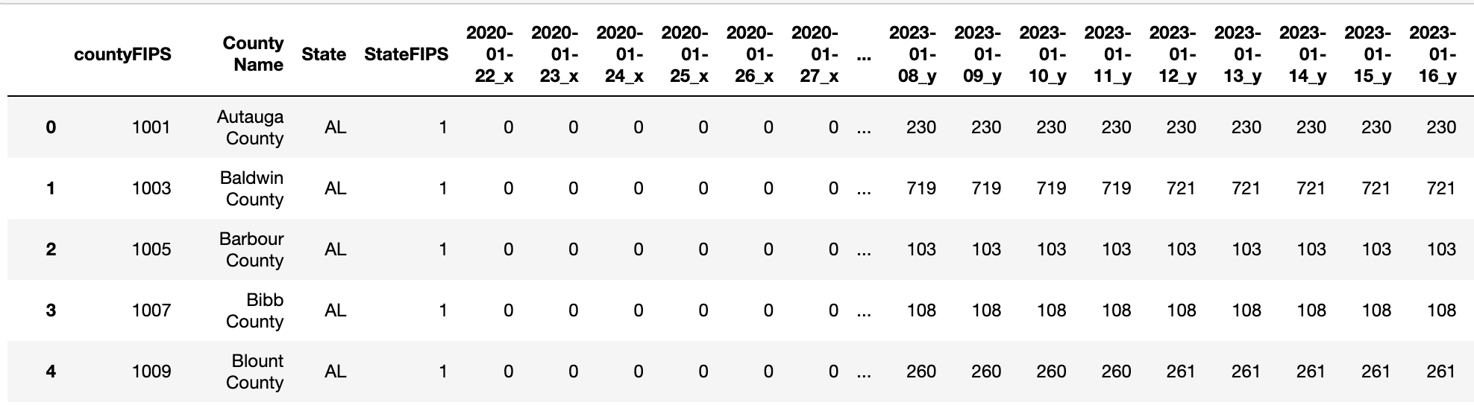
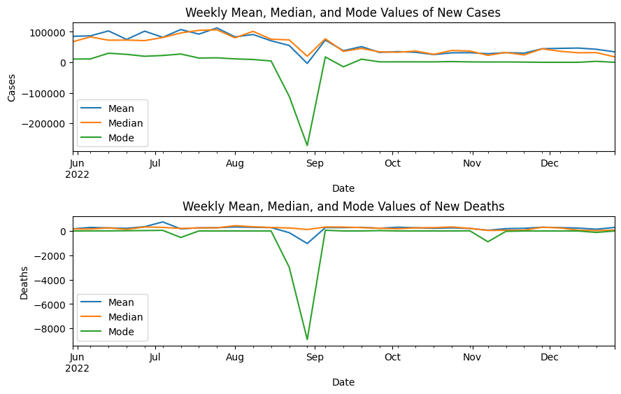
Data Exploration
Super COVID Data Frame
US Weekly Statistics Plots for New Cases and Deaths from Jun to Dec 2022
Merged all Covid Datasets (County wise Population, Cases, Deaths)
Date_x Columns indicate Total Covid Cases till Date
Date_y Columns indicate Total Covid Deaths till Date
Mean and Median values can be seen close enough in the graph, indicating the data is not much affected by outliers
Data contains negative values, indicating inconsistencies in data reporting
Can be handled by either imputing with average value of the consecutive days or by making them zero if the values are not high enough

Slide 7
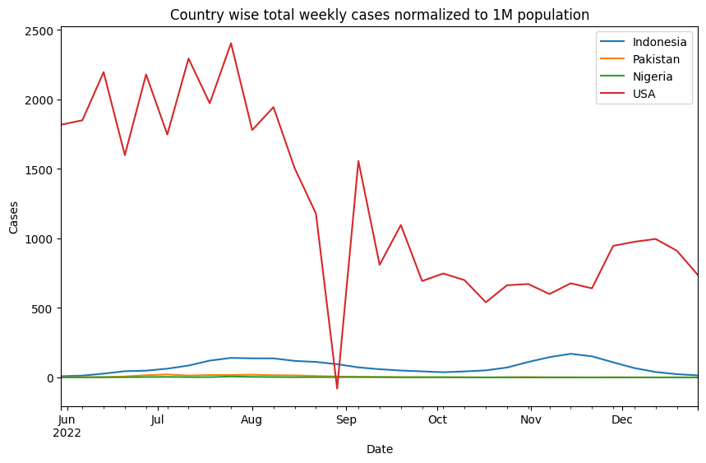
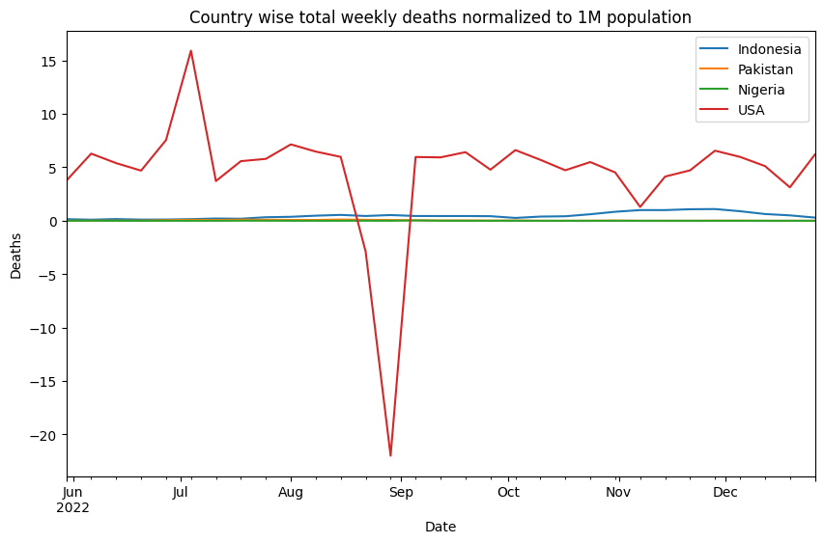
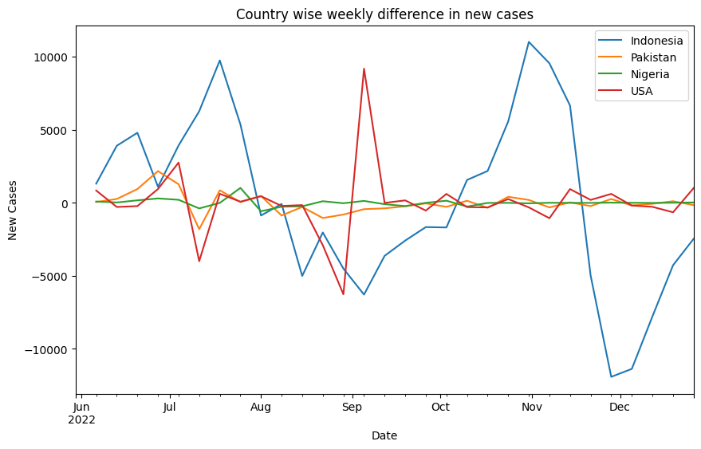
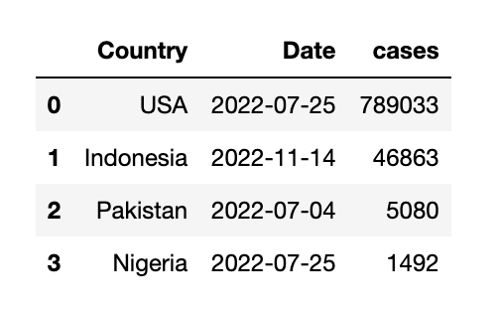
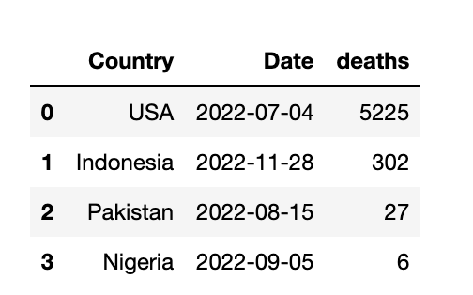
Data Exploration (Cont’d)
Comparison of US with other similar Countries
Between Jun – Dec 2022, US has a greater number of cases compared to other countries.
Negative values indicates inconsistencies in data reporting
Decline cases from July to Nov in US
Deaths look almost stable with very minimal values.
Reasons for Peaks
USA
Roe vs Wade rally: in the months of May and June
4th of July celebration(Independence Day)
Oak Fire incident: In the month of July and August
Indonesia
Outbreak of Monkey Pox
Earthquake: In the month of November Cianjur Regency, West Java
Pakistan
Mohurrum and Eid – ul – Azah during July and August
Nigeria
Relaxation of COVID restrictions after July 2022
Peak weeks
* Date column is Week starting date
Indonesia observed greater fluctuations followed by US.

Slide 8
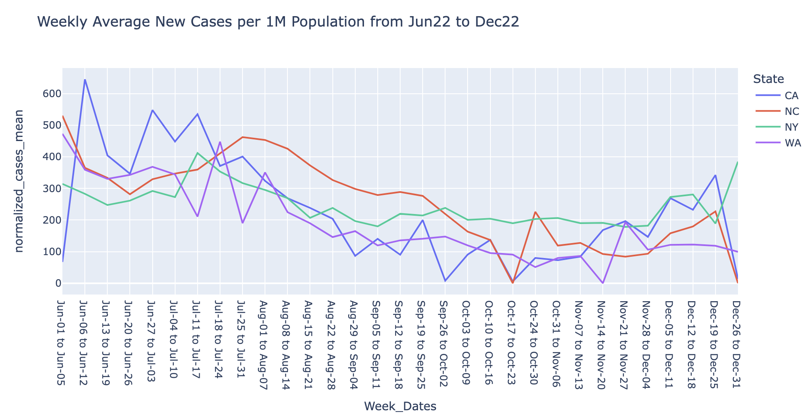
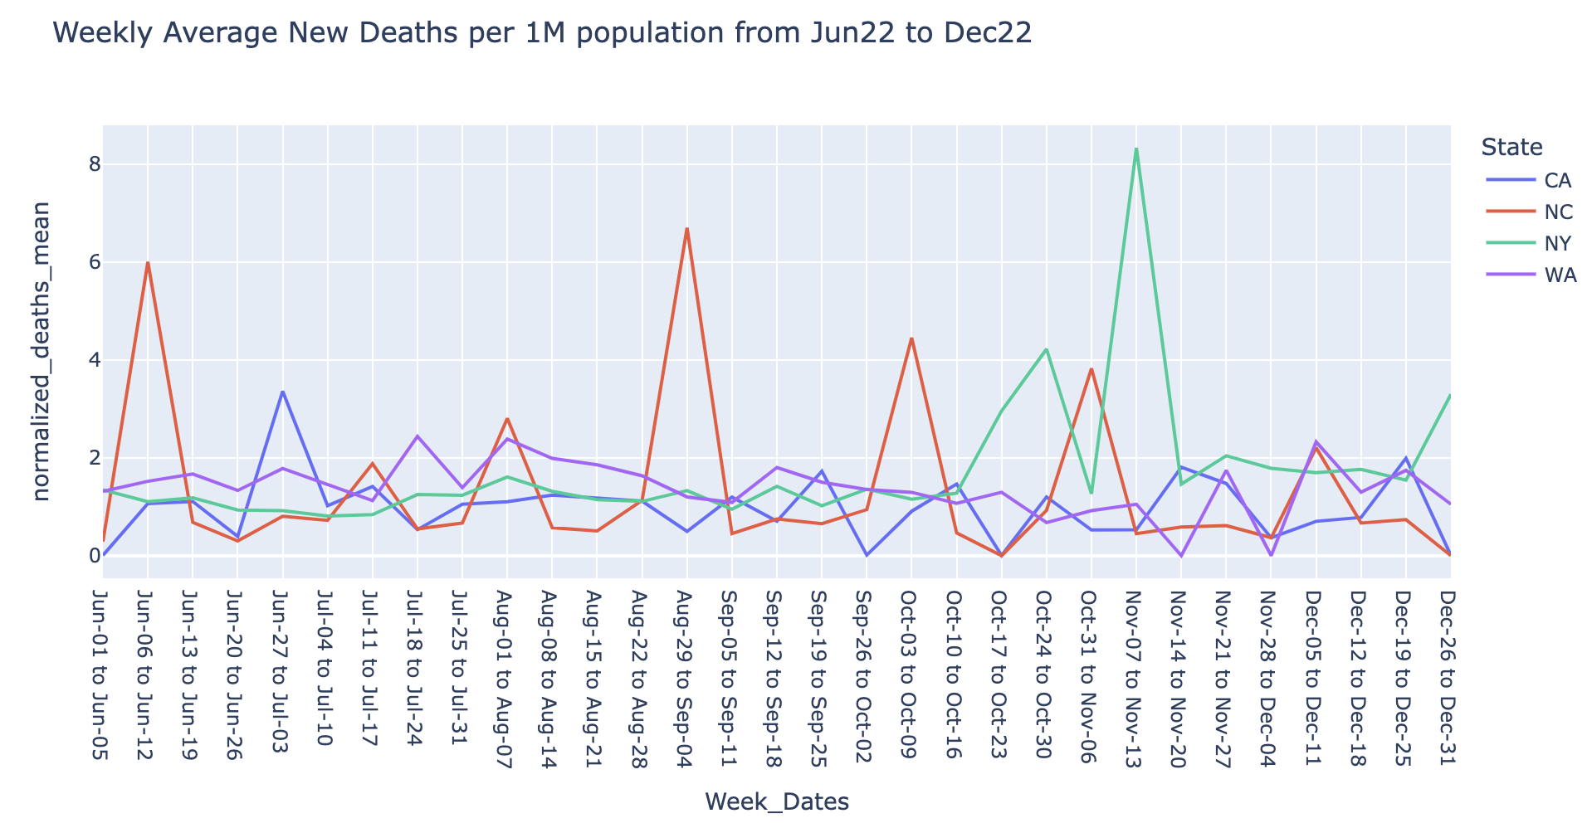
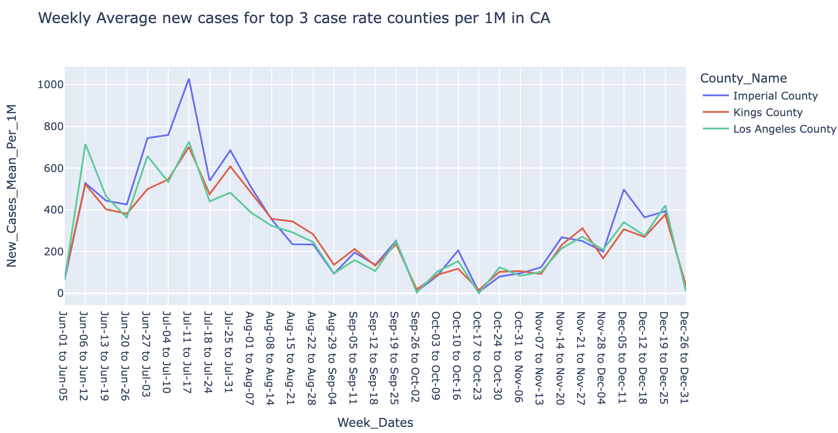
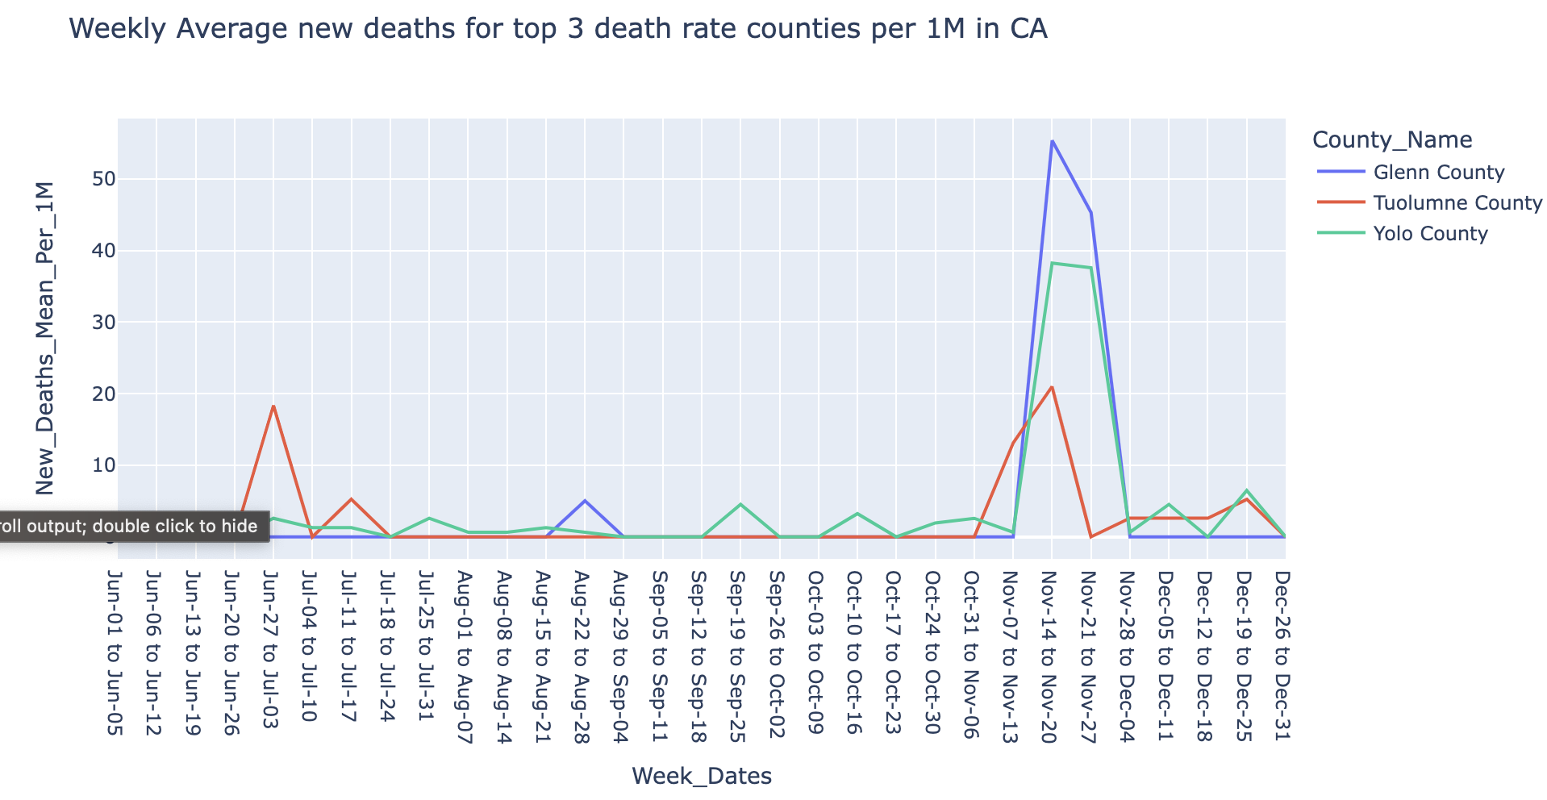
Data Exploration (Cont’d)
State Level exploration & analysis
Avg New Cases high in mid of year 2022
Decreasing till Nov and a slight increase
Probable Reasons
Summer Vacations
Thanksgiving & Christmas
Deaths are minimal for 1M population
across all states
Probable Reasons
Increased Vaccinations
Remote working conditions
Counties with High Case rate and Death rate
are geographically closely located.
The cases and deaths weekly patterns are
similar to each other.
Probable Reasons
High Population Density
Poor Medical facilities

Slide 9
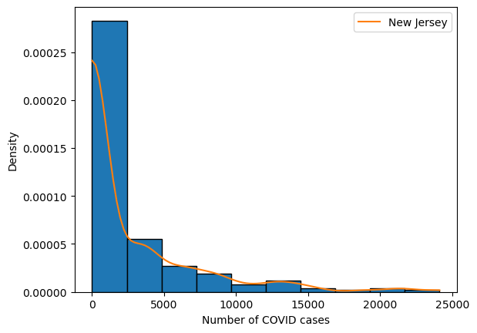
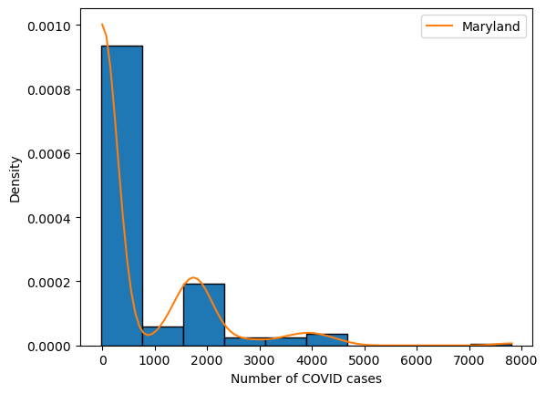
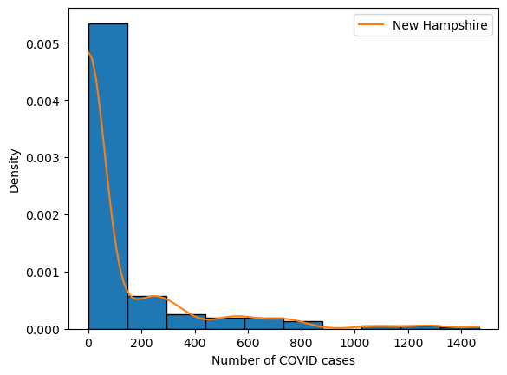
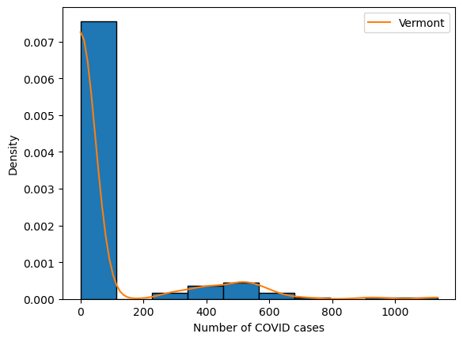
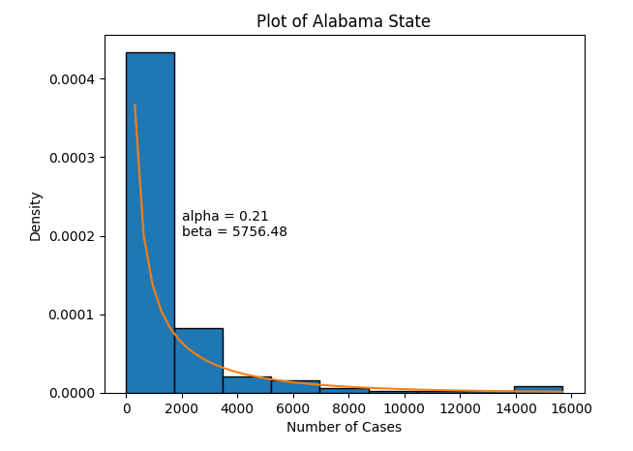
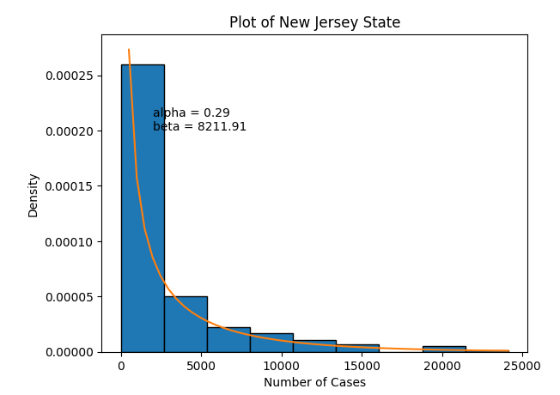
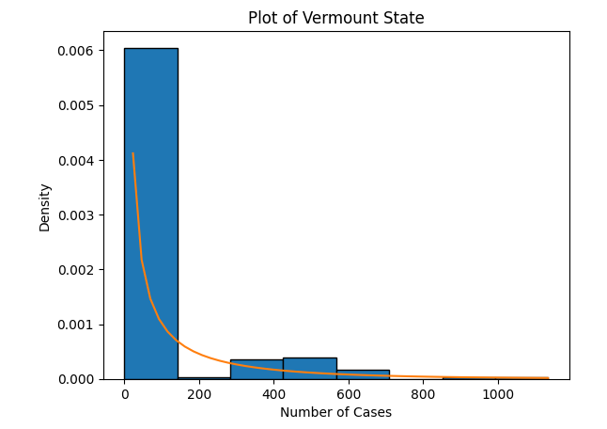
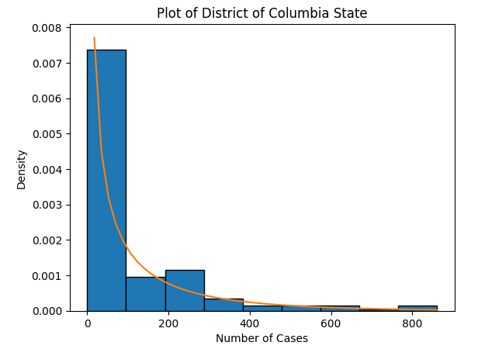
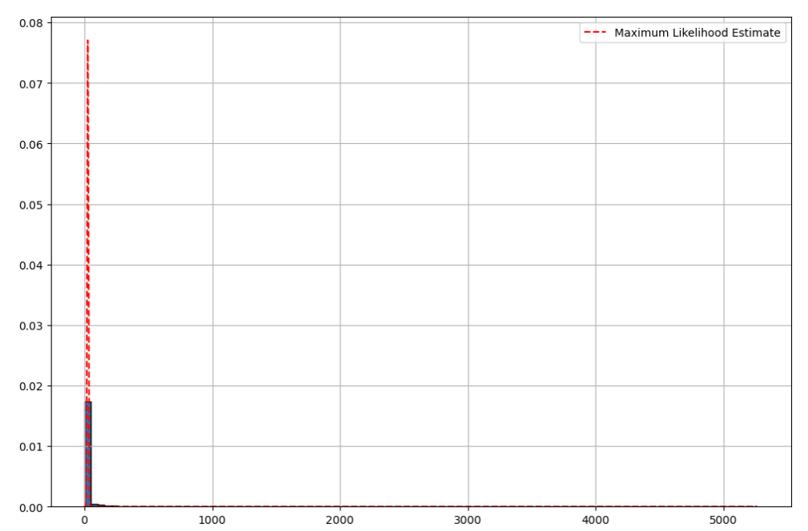
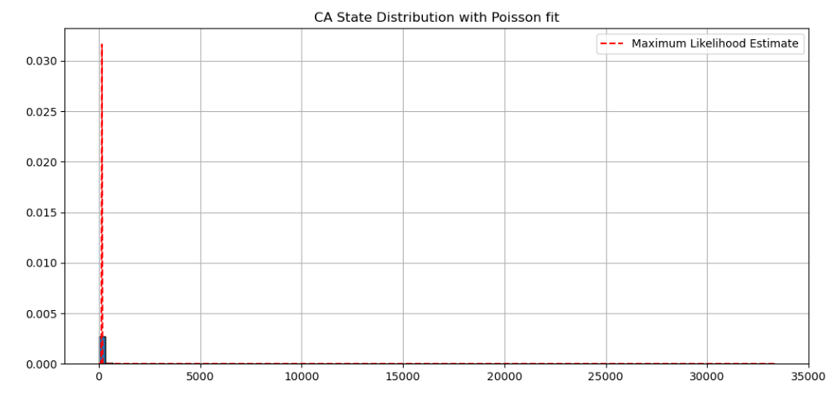
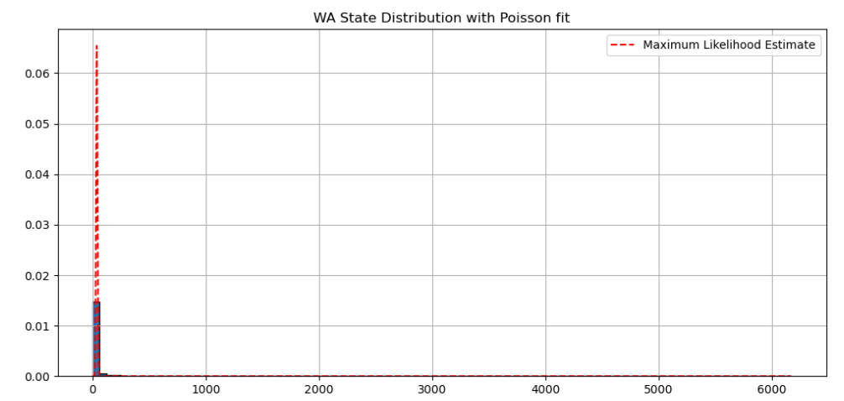
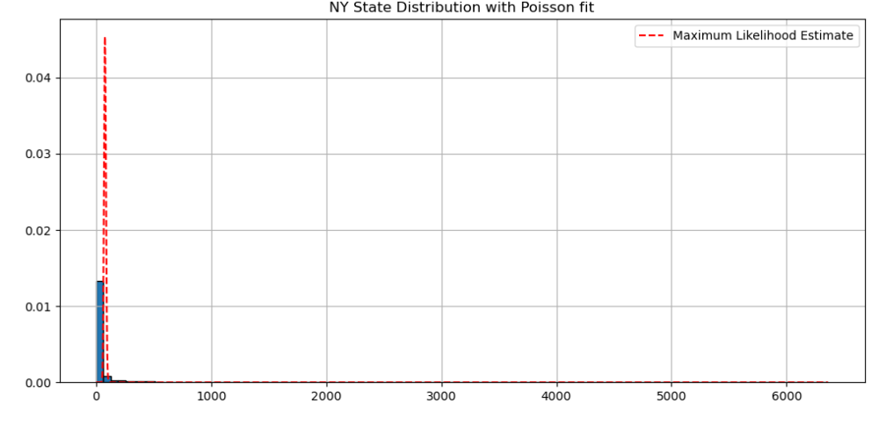
Distribution Plots
Gaussian KDE Distribution Plots
Distribution of Covid cases across all states have right tail
Since covid impact is reduced by Jun 2022, fewer daily new cases are observed
We considered Poisson distribution for Maximum Likelihood analysis
Method of Moments Distribution Plots
Maximum Likelihood Distribution Plots

Slide 10
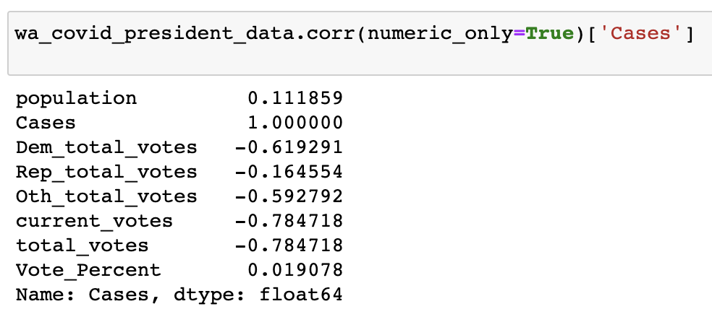
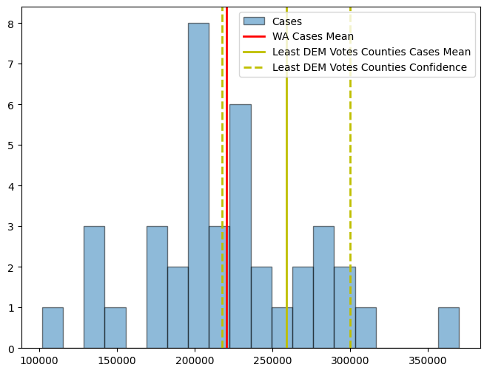
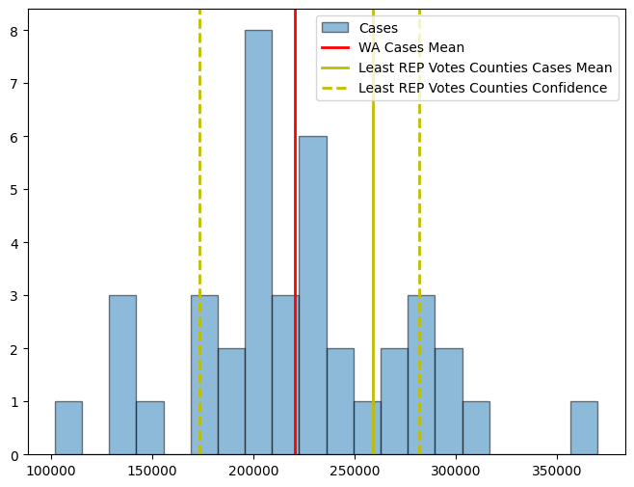
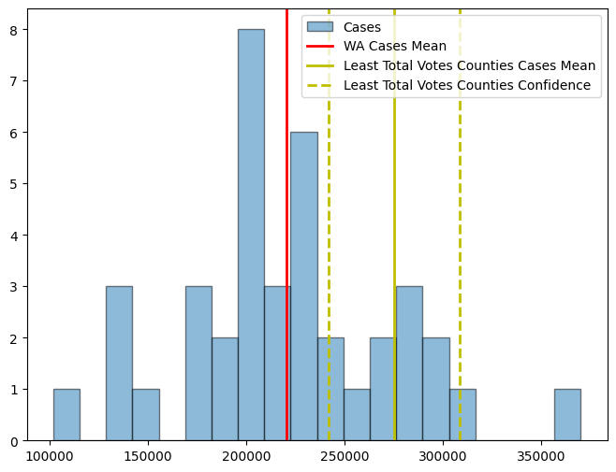
Correlation with Enrichment Data & Hypothesis Testing
S.No | Null Hypothesis | Alternate Hypothesis | p- Value
1 | Mean of WA state cases is greater or equal to the mean of cases of counties with Low Democratic votes | Mean of WA state cases is less than the mean of cases of counties with Low Democratic total votes | 0.038 Reject Null Hypothesis
2 | Mean of WA state cases is greater or equal to the mean of cases of counties with Low Republic votes | Mean of WA state cases is less than the mean of cases of counties with Low Republic total votes | 0.393 Fail to Reject Null Hypothesis
3 | Mean of WA state cases is greater or equal to the mean of cases of counties with total votes | Mean of WA state cases is less than the mean of cases of counties with Low total votes | 0.003 Reject Null Hypothesis
Visualization of mean values with 95% Confidence interval

Slide 11
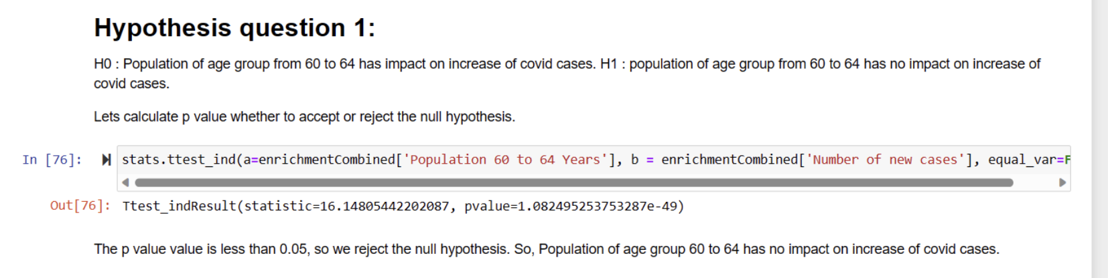
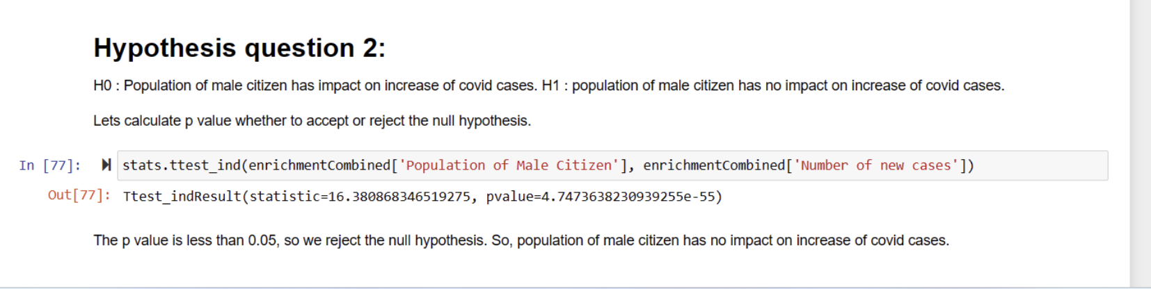
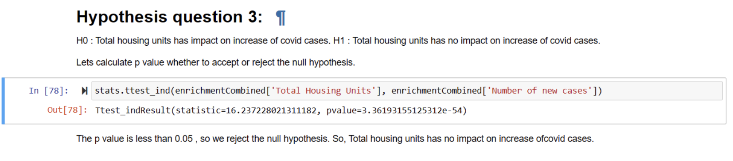
Few Other Hypothesis testing

Slide 12
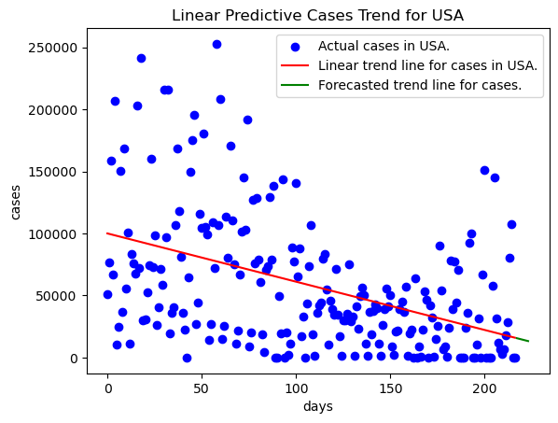
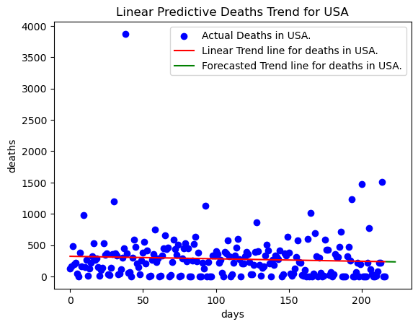
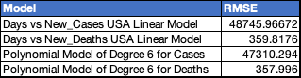
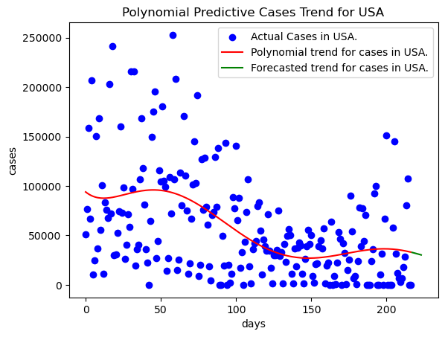
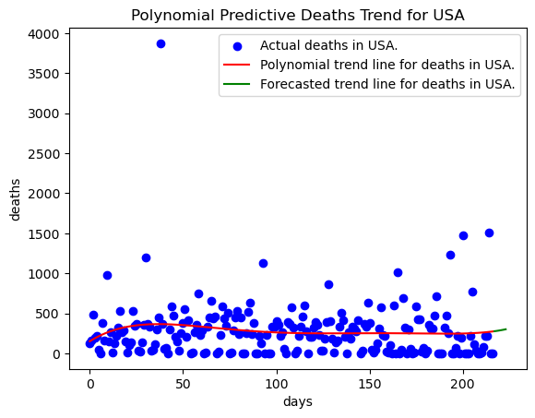
Modeling Covid Data of US

Slide 13
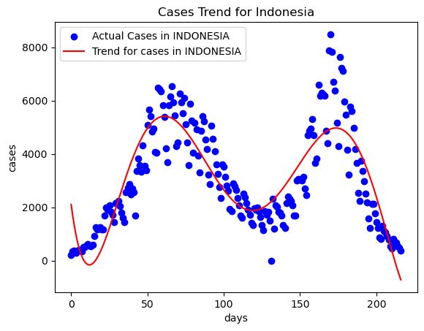
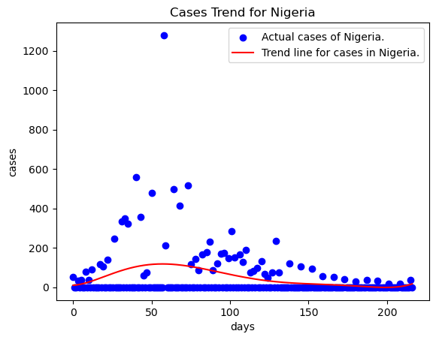
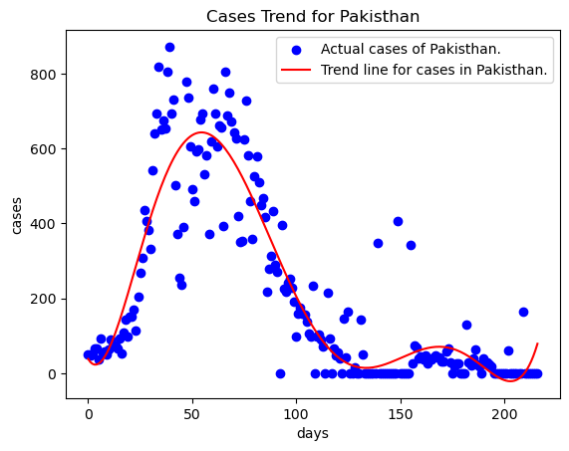
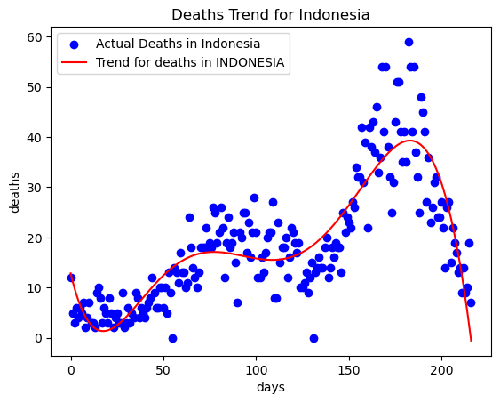
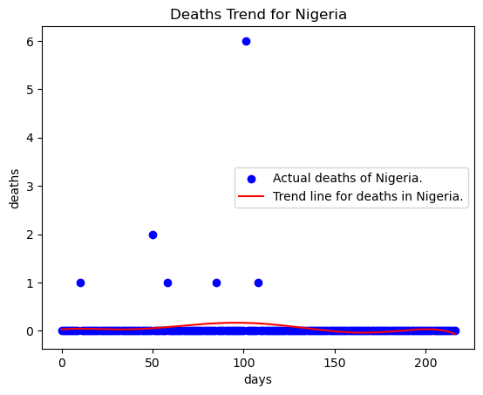
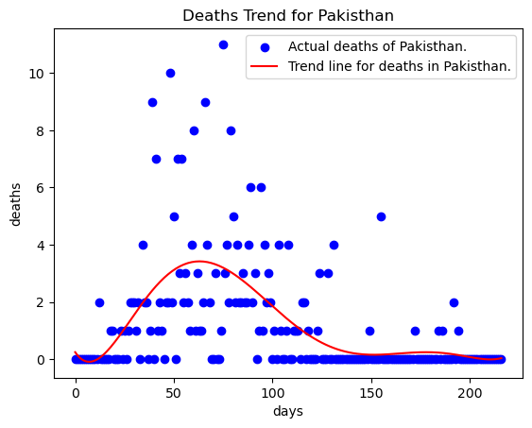
Modeling Covid Data of other countries

Slide 14
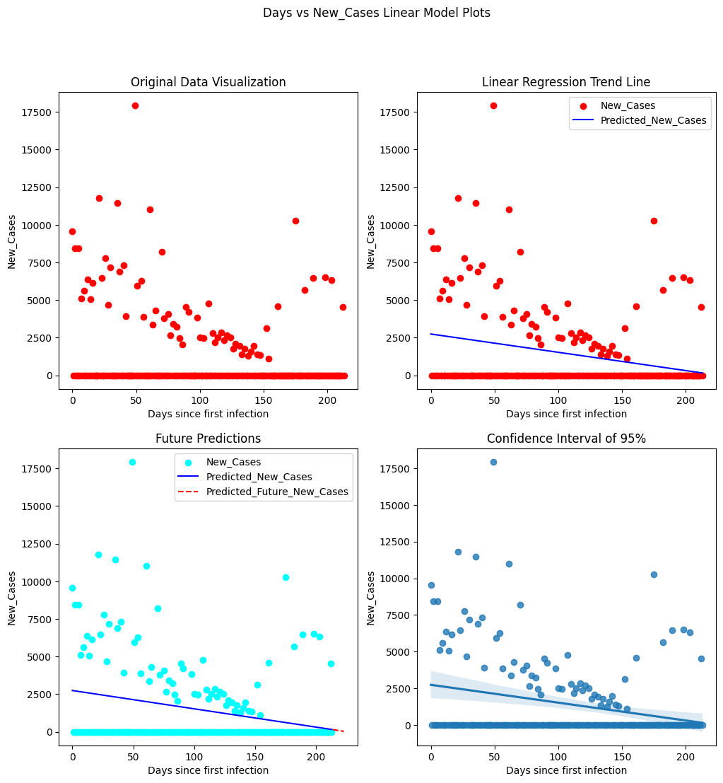
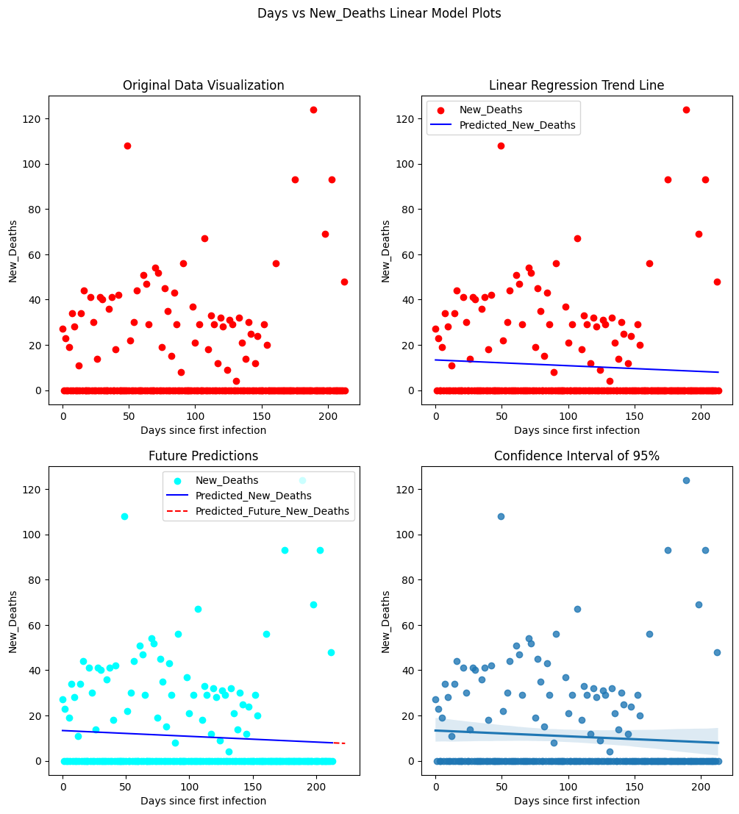
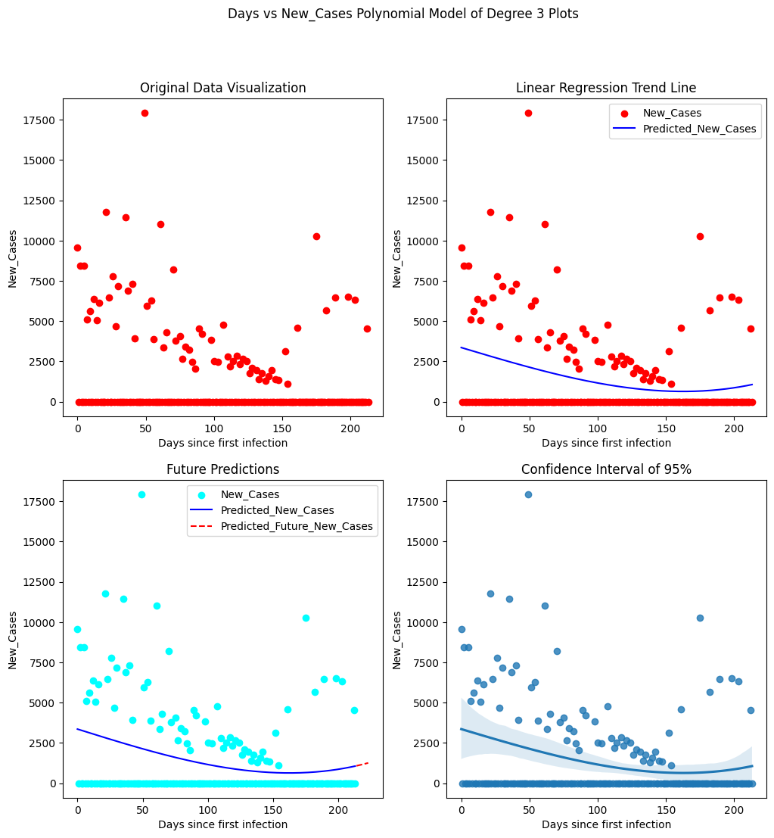
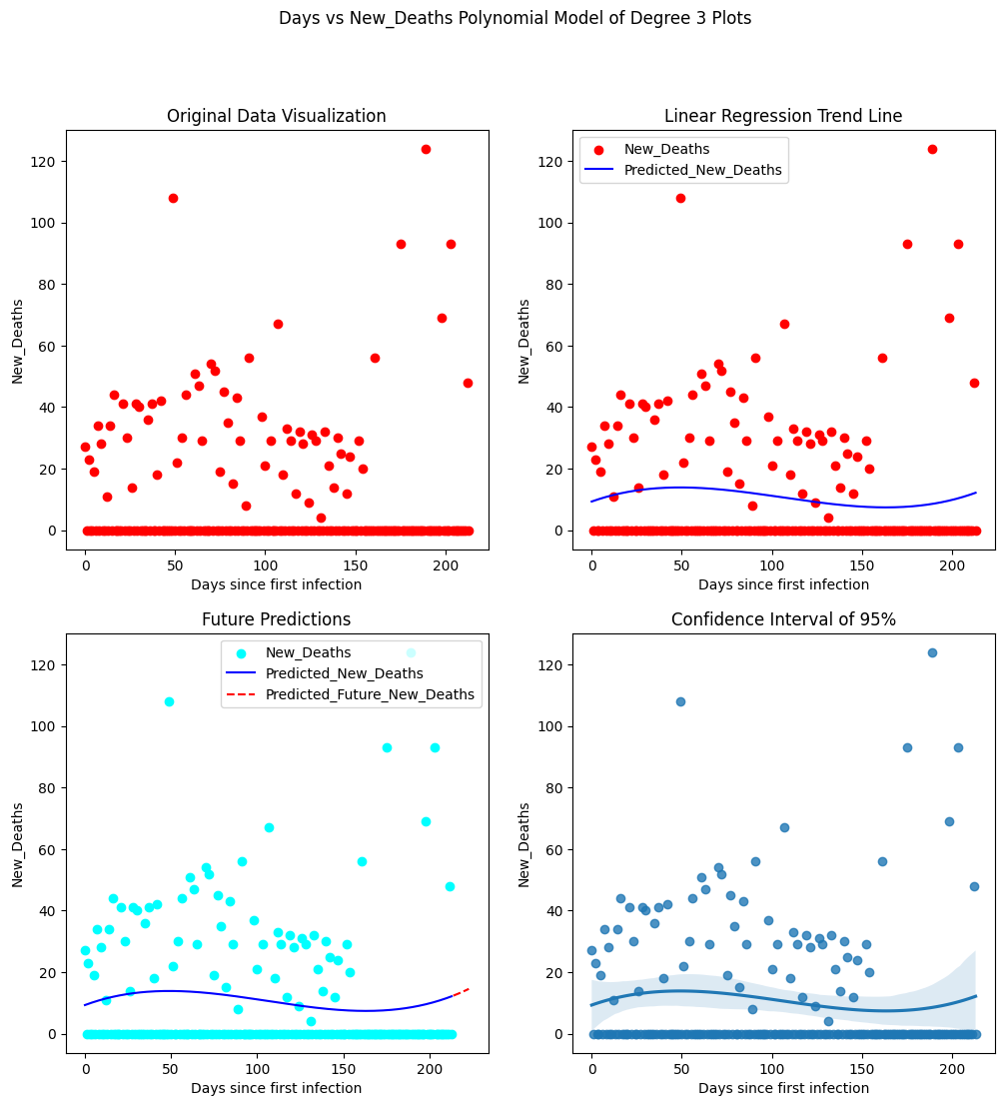
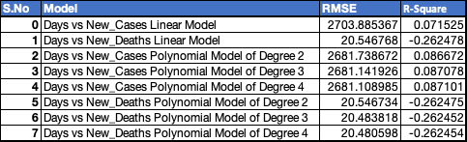
Modeling Covid Data of WA state
Linear Model of WA Cases
Linear Model of WA Deaths
Degree 3 Polynomial Linear Model of WA Cases
Degree 3 Polynomial Linear Model of WA Deaths
Different WA state COVID Prediction Models’ RMSE values

Slide 15
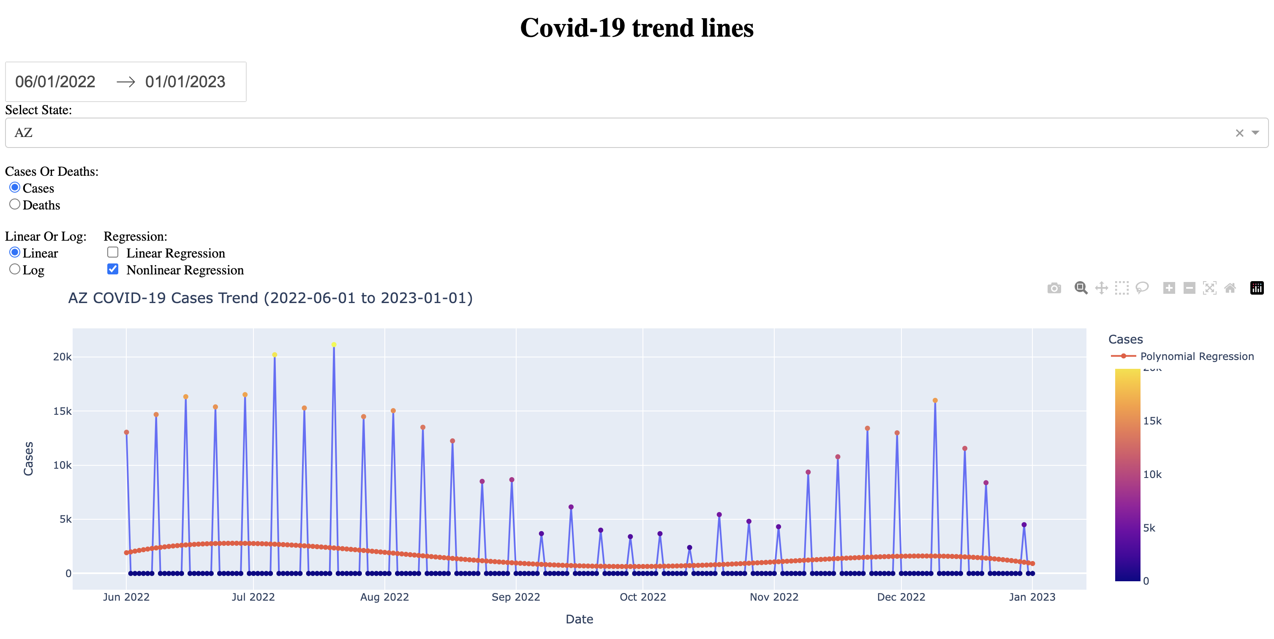

Dashboard
Interactive Dashboards
Built using Dash
Filter Options
Date Range
State
Cases/Deaths
Linear/Log
Regression Type

Slide 16
Summary & Insights
Low Covid Cases during the assessed period Jun 22 to Dec 22
Due to Prevention Methods
Vaccination & Increase in immunization
Remote work, online classes etc. wherever possible
Peaks during every Holiday season and public gathering events
People still should be vigilant when attending crowded events
Linear & Polynomial regression didn’t fit all the data properly.
Using timeseries models or other ML models would have improved the model predictions

Slide 17
References
US COVID-19 Cases and Deaths by State https://usafacts.org/visualizations/coronavirus-covid-19-spread-map/
Census Demographic ACS https://data.census.gov/cedsci/table?q=dp&tid=ACSDP1Y2018.DP05
ACS Social, Economic, and Housing https://data.census.gov/cedsci/table?q=dp&tid=ACSDP1Y2018.DP05
Employment Dataset https://www.bls.gov/cew/downloadable-data-files.htm
Presidential Election Results (Political Leanings) https://www.kaggle.com/unanimad/us-election-2020
Hospital Beds Dataset https://protect-public.hhs.gov/pages/hospital-utilization
What is a data dictionary? A simple and thorough overview. https://analystanswers.com/what-is-a-data-dictionary-a-simple-thorough-overview/
Our World Data https://analystanswers.com/what-is-a-data-dictionary-a-simple-thorough-overview/
How to plot a Confidence Interval in Python. https://www.statology.org/plot-confidence-interval-python/

Slide 19

Appendix
Hospital Data

